Slide 1

Home Credit Risk Analytics
by BI Analyst Jermaine Samuels

Slide 2
Introduction
Predict Loan Default using Data Analytics
Combine Datasets to create holistic view
Why Big Data Analytics? Experience not enough
Benefits of Data Analytics

Slide 3
OBJECTIVE
To build a predictive model for loan payment default and to reduce that probability by 20%

Slide 4
BIG Data Analytics impact
Risk Analytics – Assess the source and minimize the impact
Real Time Analytics – Understanding data gives competitive advantage
Consumer Analytics – Prescribe the best solutions

Slide 5
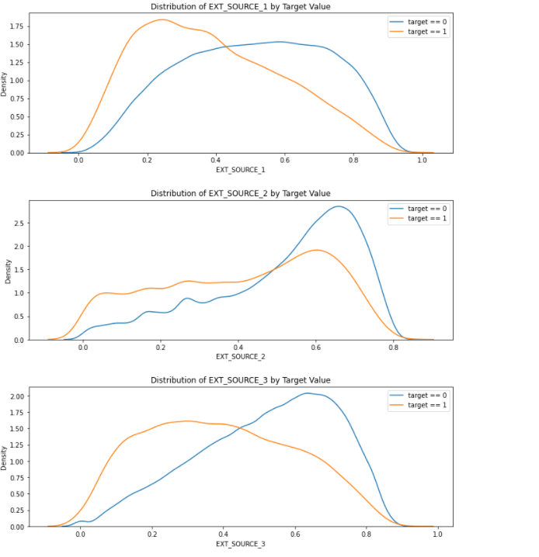
Home Credit EDA
Review Credit distribution based on risk
Identify groups at risk to default
External Credit sources suggest liabilities
Dimensionality reduction required

Slide 6
Model Type Description
Random Forest was the more accurate of the two.
Tuned Parameters utilized ‘gini’ to calculate degree of variance.
Logistic Regression
Random Forest

Slide 7
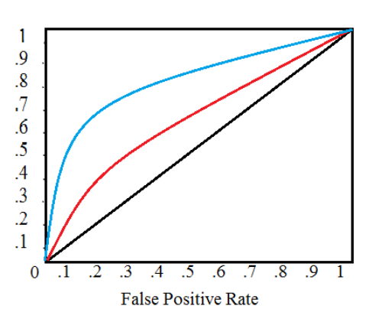
Random Forest model results
Accuracy > 70%
Area under the Curve > 69%
Number of nodes > 10

Slide 8
Deployment
Sync Data sources
Establish Data Pipeline
Scripting
Testing
Visualization

Slide 9
Visualization structure
Story Board
Goal | Snapshot – Reduce Default Probability
Trends – What is increasing Default Probability
Actions – What Actions will reduce default Probability

Slide 10

Conclusion
Implementation of Big Data Analytics provides unique insights specific to individual items in a dataset improving business intelligence.

Slide 11
References
Case study link:
https://www.kaggle.com/c/home-credit-default-risk/data
Top financial issues
https://www.upgrad.com/blog/data-science-use-cases-finance-industry/
Data Problems
https://rtslabs.com/3-common-data-problems-financial-services-firms-face-and-how-to-solve-them/

